Slide 1
Surface Hydrologic Features Conceptual Mode: HY_Features
Presentation of initial RFC draft to OGC Architecture Board: 09-13-2016
David Blodgett and Irina Dornblut
dblodgett@usgs.gov Dornblut@bafg.de

Slide 2
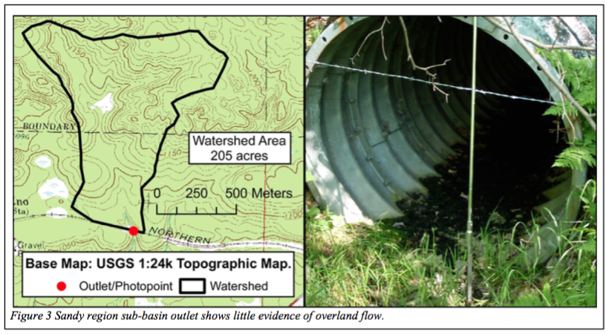
What is an outfall?

Slide 3
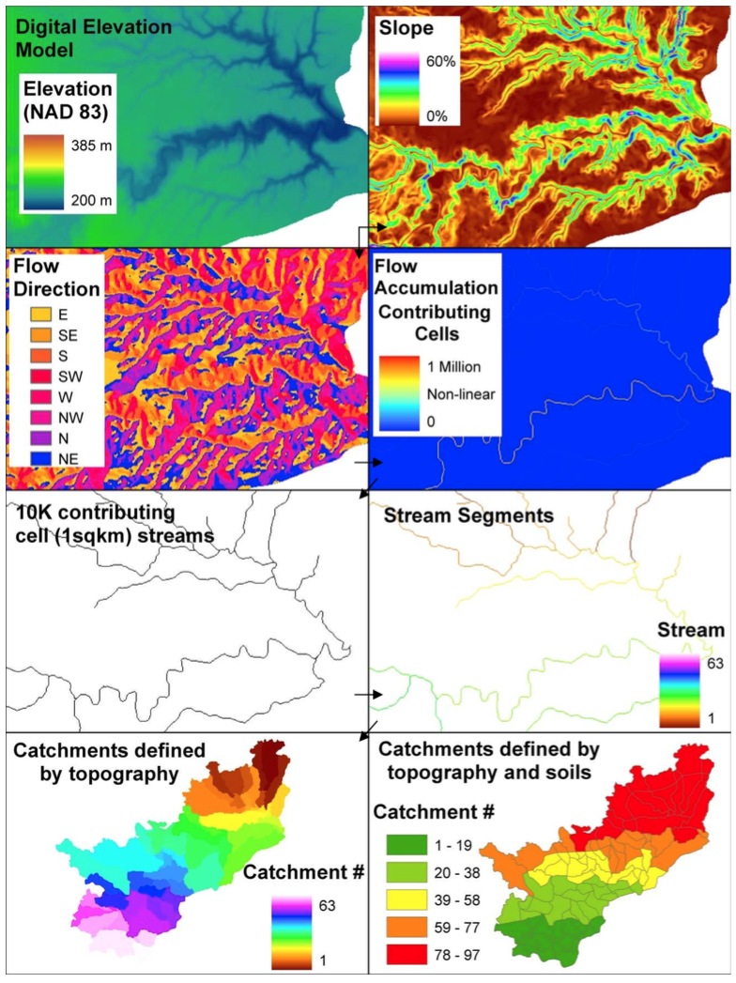
Elevation-Derived Hydrography
Elevation
Flow Direction
Flow Accumulation
Streams
Segmented Streams
Catchments

Slide 4
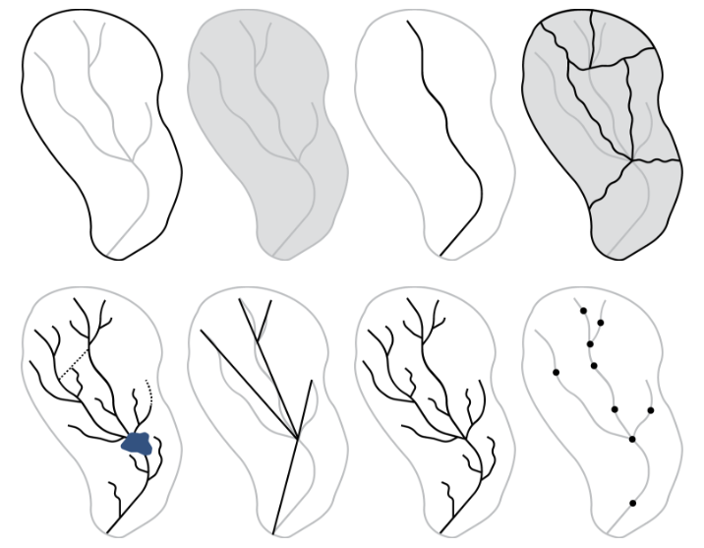
What’s a watershed?

Slide 5
How do we identify these as the same?

Slide 6
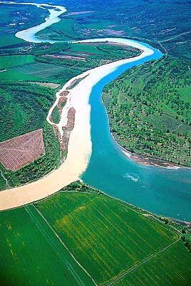
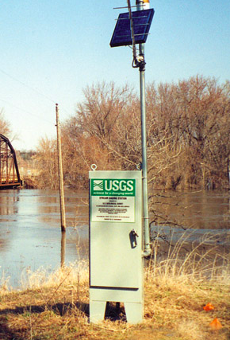
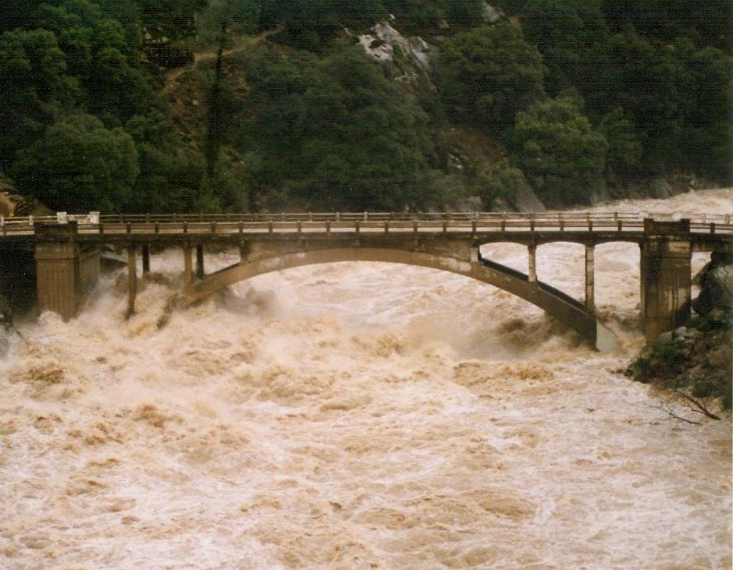
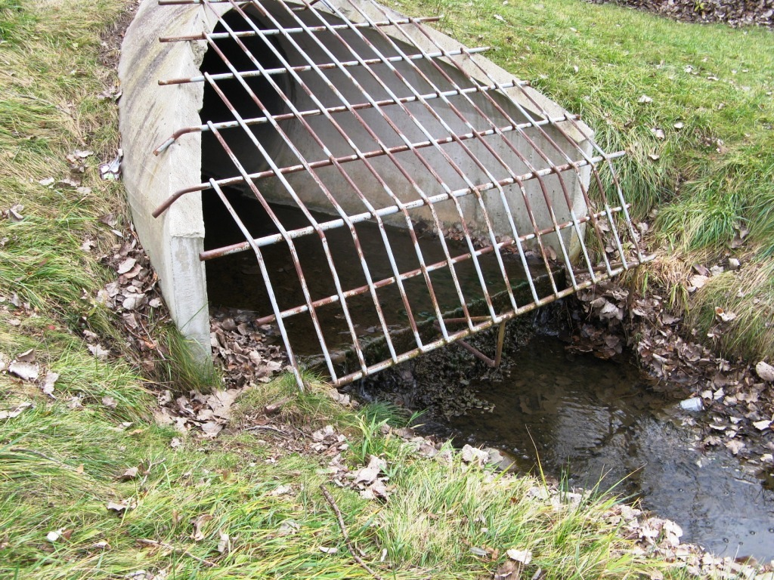
Lots of types of outfalls….

Slide 7
Do we need a spatial data at all? Realization vs. Representation
A watershed may be realized as a description and have relationships to other watersheds.
E.g. The missouri has a wikipedia page and flows into the mississippi.
A watershed’s realizations may be represented with geometry.
E.g. The missouri river’s boundary realization has polygon representation.

Slide 8
HY_Features and HY_Catchment
Internationally harmonized concepts for identification and description of hydrologic data.
An HY_Catchment is a conceptual feature which may be realized by a feature that has a geometric representation.

Slide 9
HY_Features… What’s in the box?
Core Catchment Network
Catchment specializations, realizations, and relationships.
Catchment outfalls nodes and linear referencing.
Hydrographic Network
Water bodies, channels, and relationships.
Hydrometric Network
Hydrometric station features and relationships.

Slide 10
Catchment Nesting and Crossing Scale

